Slide 1
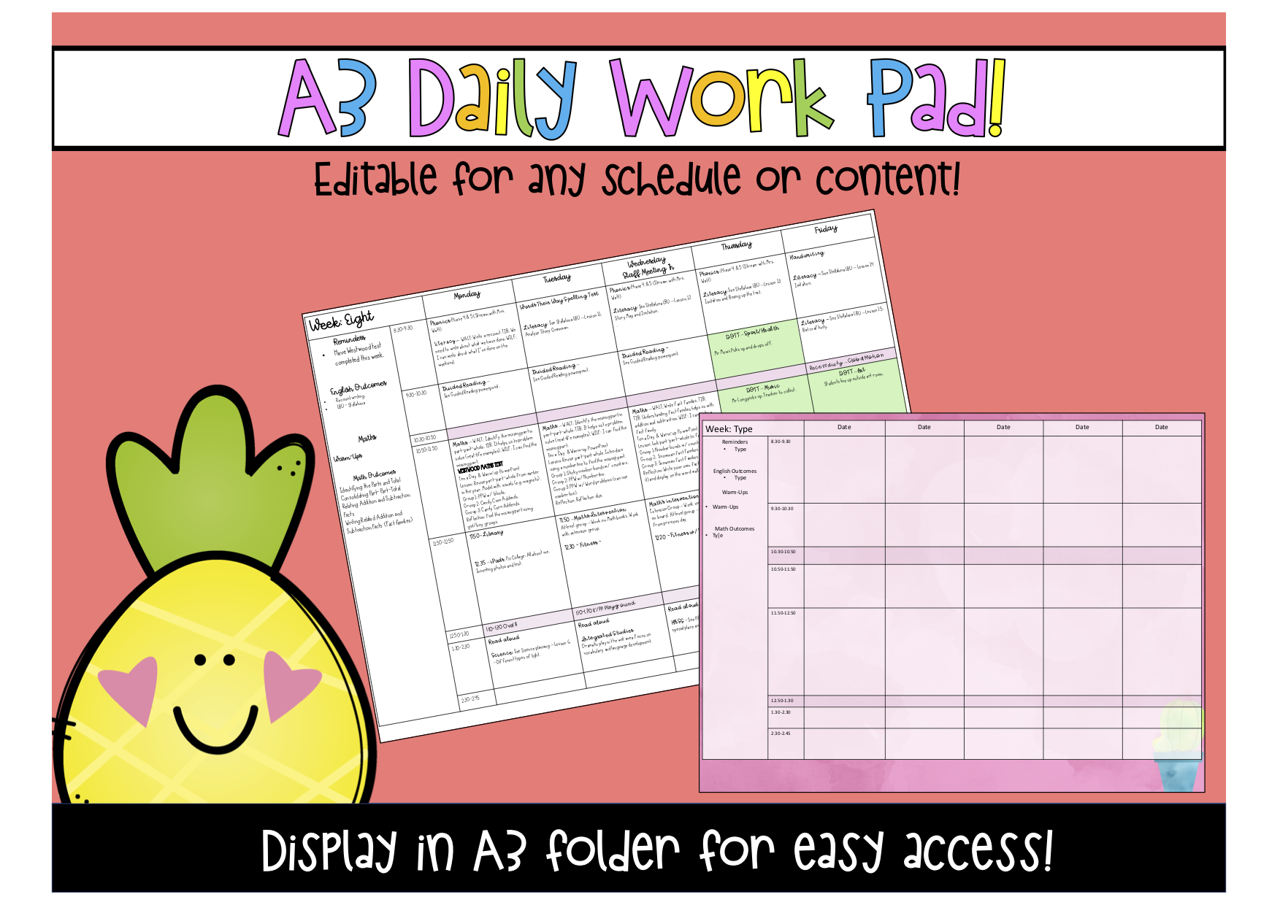

Slide 2


Slide 3
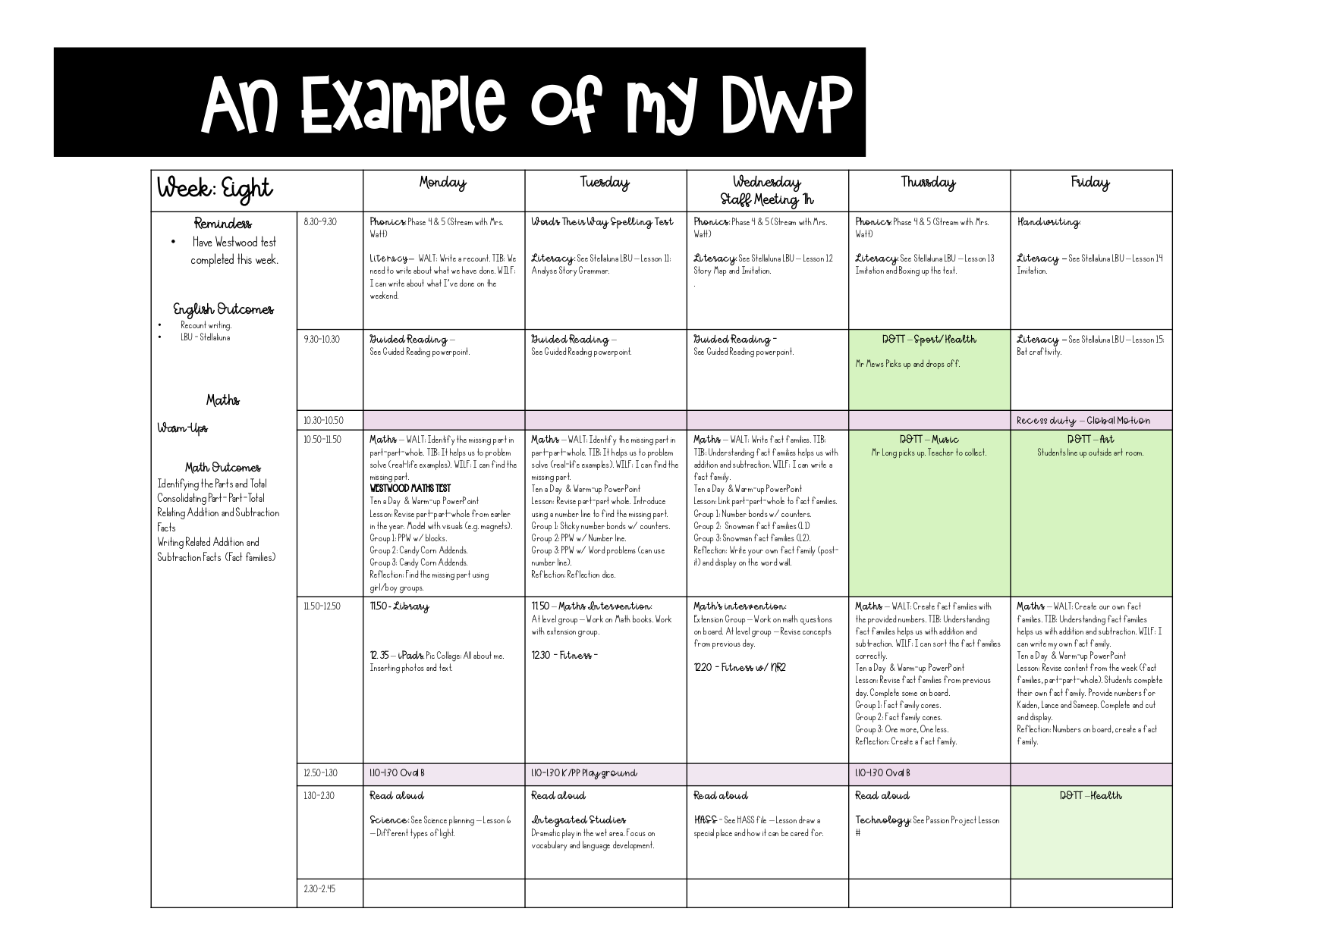

Slide 4
Week: Type |  | Date | Date | Date | Date | Date
Reminders Type English Outcomes Type Warm-Ups Type Math Outcomes Ty[e | 8.30-9.30
 | 9.30-10.30
 | 10.30-10.50
 | 10.50-11.50
 | 11.50-12.50
 | 12.50-1.30
 | 1.30-2.30
 | 2.30-2.45

Slide 5

Week: Type |  | Date | Date | Date | Date | Date
Reminders Type English Outcomes Type Warm-Ups Warm-Ups Math Outcomes Ty[e | 8.30-9.30
 | 9.30-10.30
 | 10.30-10.50
 | 10.50-11.50
 | 11.50-12.50
 | 12.50-1.30
 | 1.30-2.30
 | 2.30-2.45

Slide 6


